Slide 1
SMA & HULL TACTICAL Week 10

Slide 2
Today’s Outline
CAPM / SML Regression Variables
Annualized Performance Metrics
Performance Analytics: 2018 - 2019
Notes:
Main point of this week: feature filtering

Slide 3
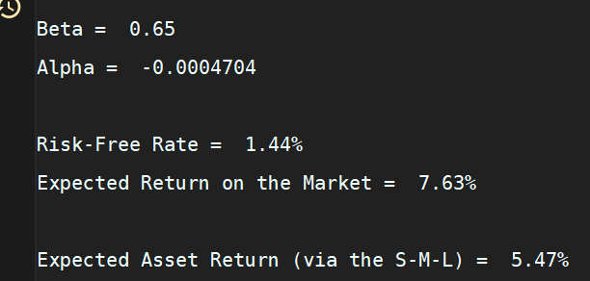
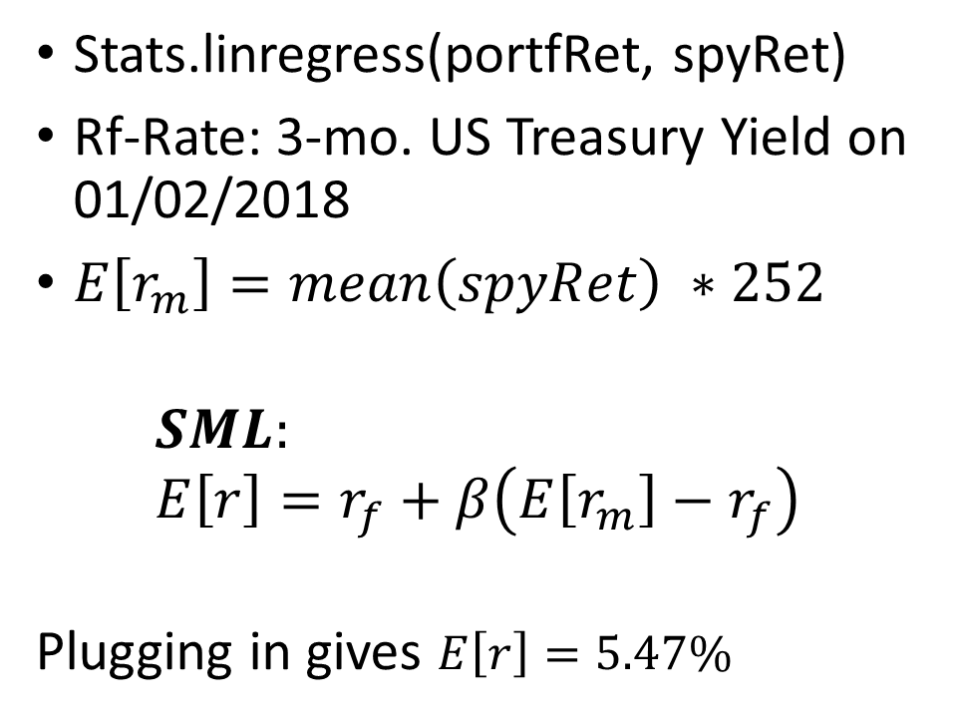
CAPM Variables: Alpha/Beta
Stats.linregress(portfRet, spyRet)
Rf-Rate: 3-mo. US Treasury Yield on 01/02/2018
$E\left[r_{m}\right]=mean\left(spyRet\right) ∗252$
$$SML: \\ E\left[r\right]=r_{f}+β\left(E\left[r_{m}\right]−r_{f}\right)$$
Plugging in gives $E\left[r\right]=5.47\%$

Slide 4
Key Metrics (Annualized)

Slide 5
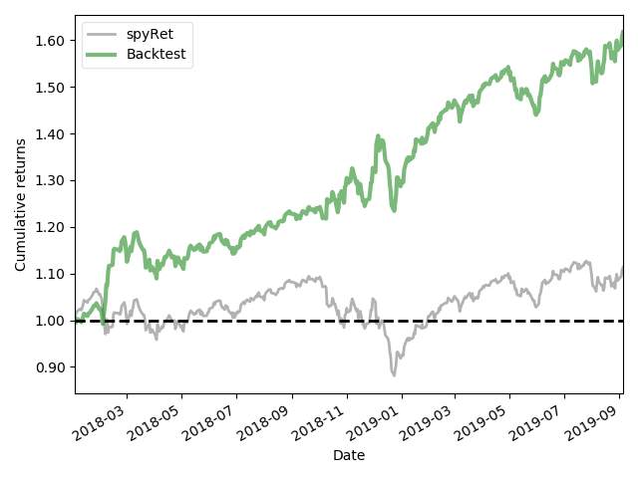
Performance Report:

Slide 6
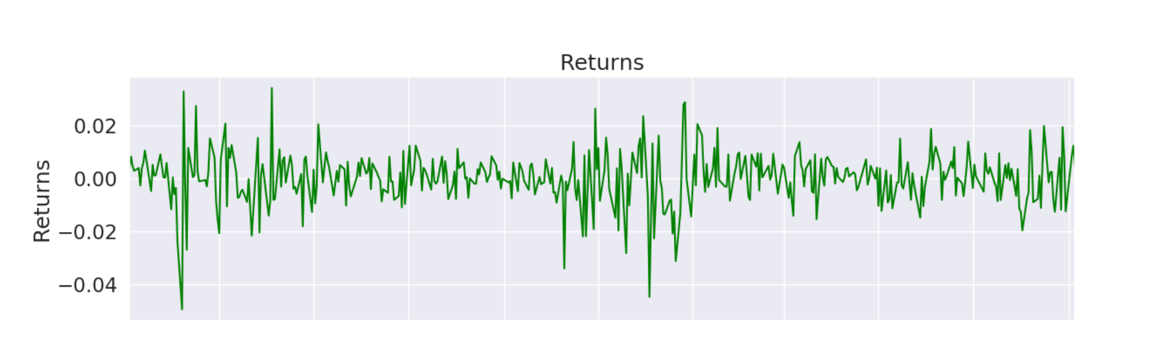
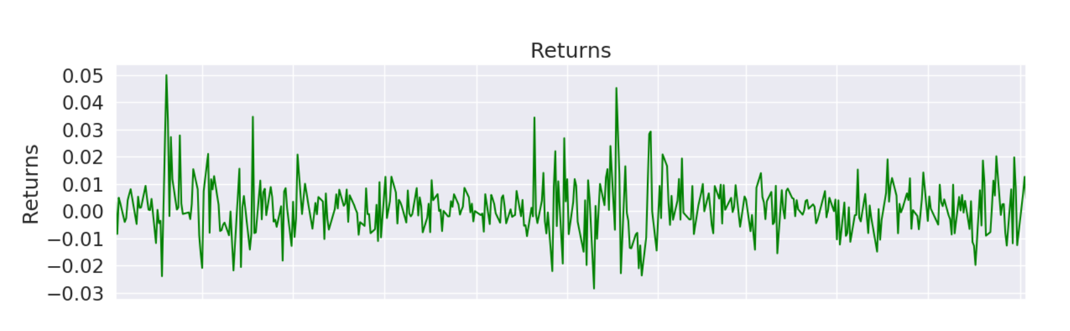
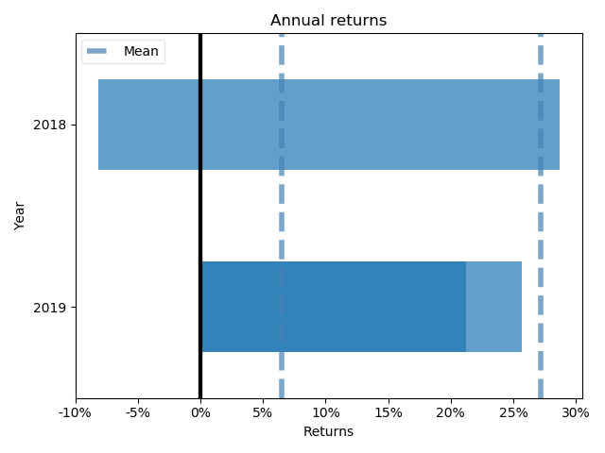
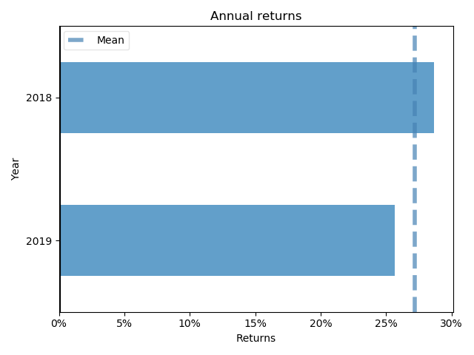
SPY Returns: Daily & Annual
Portfolio Returns: Daily & Annual

Slide 7
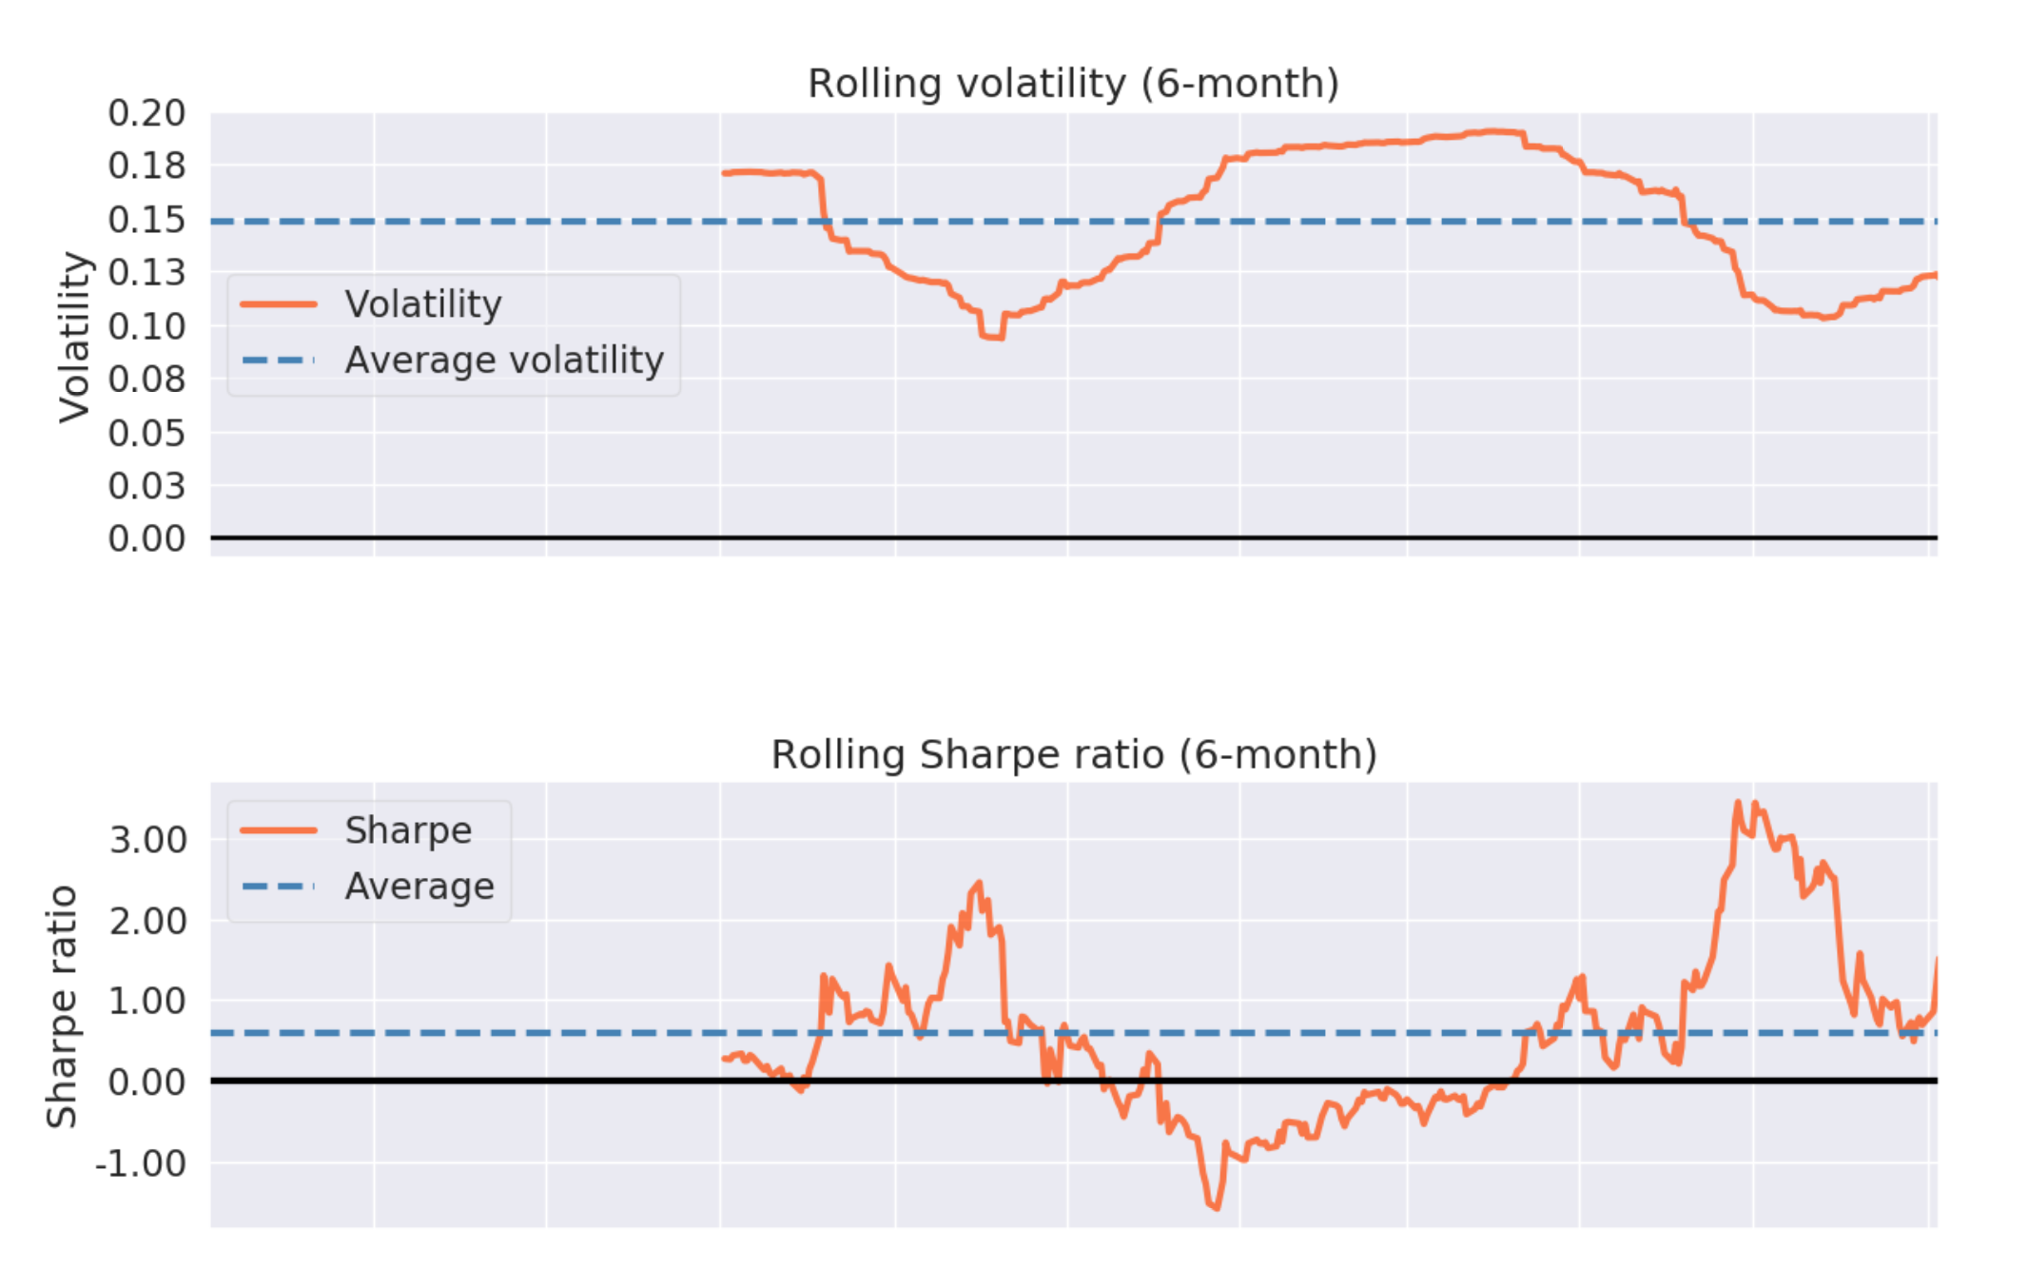
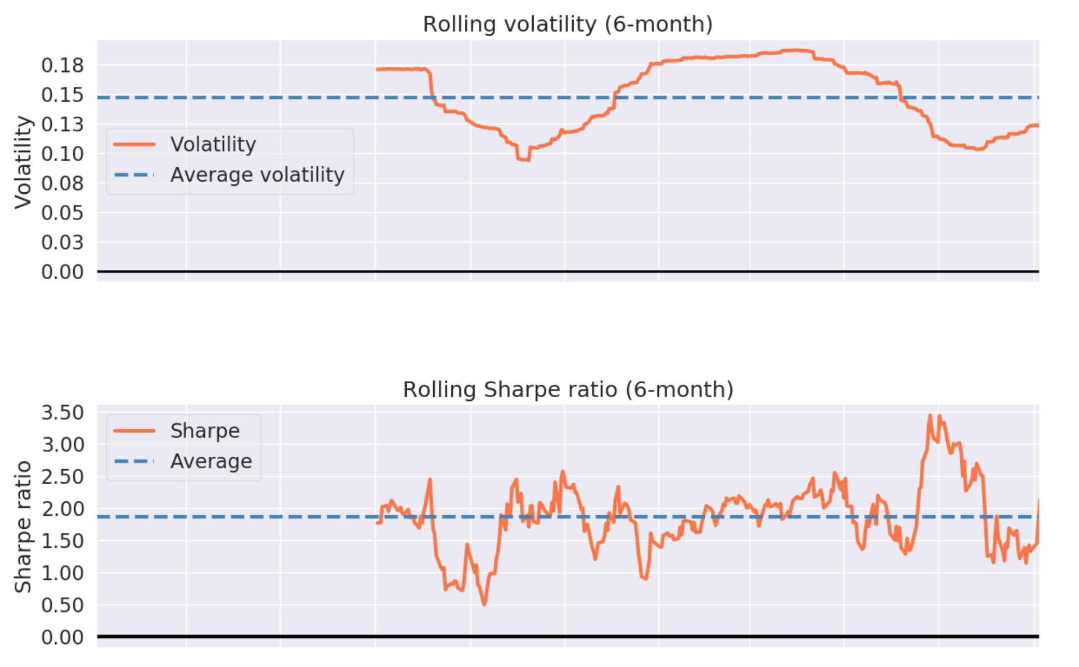
Rolling 6-mo. Volatility & Sharpe Ratio
SPY
Portfolio

Slide 8
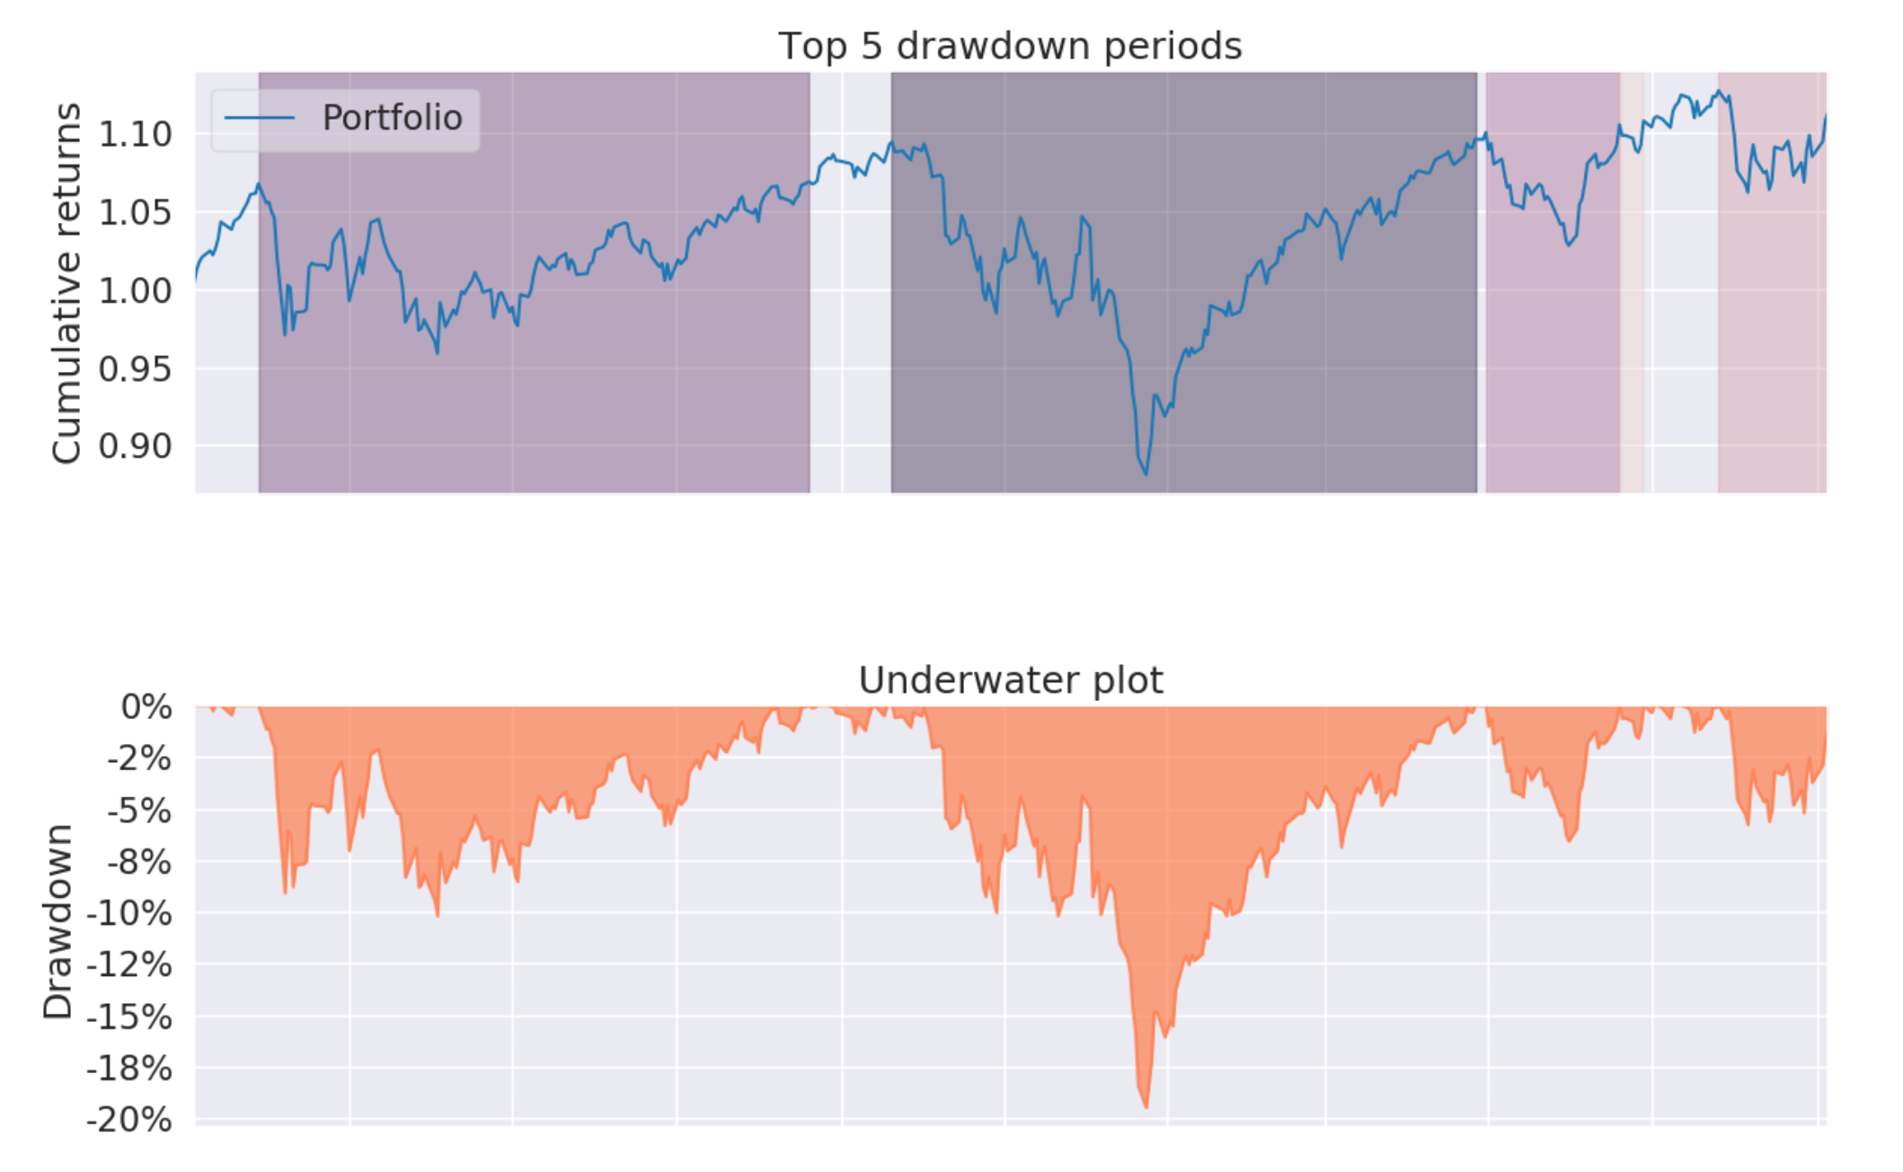
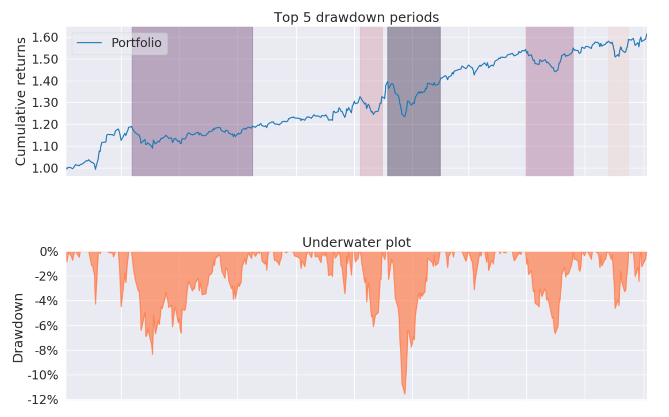
Risk Report: Top Drawdown Periods
SPY
Portfolio

Slide 9
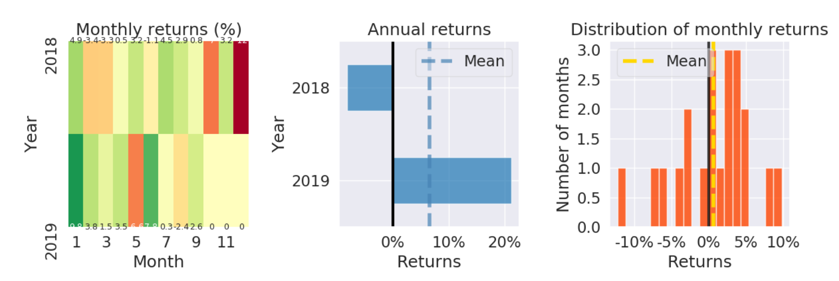
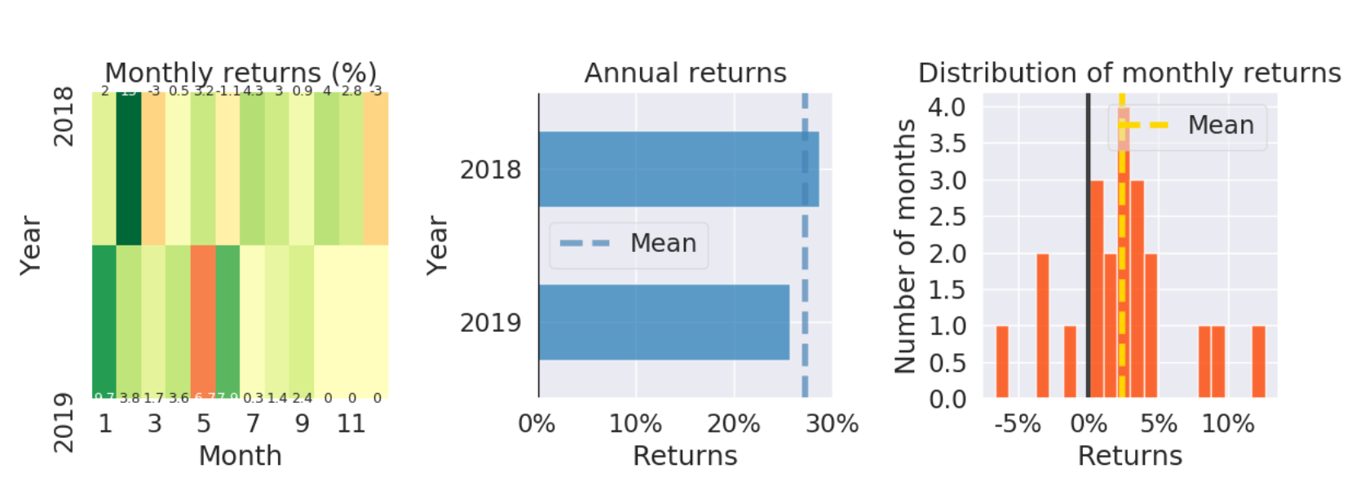
Monthly Return Distributions & Heatmap
SPY Dist.
Portfolio Dist.

Slide 10
Thank you!
Notes:
PCA is orthorgonal transformation of each factor

